Slide 1
Intelligent Hand Gesture Based Security System
Group 3
Presenters:
Fariha Ferdousi 1706143
Nausin Tabassum Kudrot 1706158
Sadia Afrose 1706161
Raisa Mashtura 1706163
Subah Karnine 1706174
Presented To:
Sameia Zaman
Shahed-E-Zumrat
Md. Sadman Sakib

Slide 2


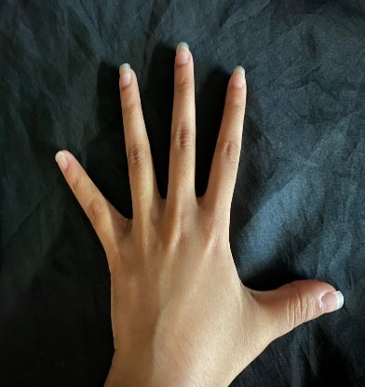
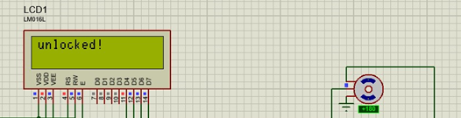
About Our Project
Virtual security system
Opens door with a 5 digit password
The digits are read from hand gestures
Digit = number of fingers in a timeframe
The images show a snapshot of our hand taken from a mobile phone camera and the image processing output

Slide 3
Why this project?
Safe althernative to retina scan or finger print based security system
During a pandemic situation like in the current statusquo, minimizing human contact with machines is a goal
Easy implementation in real life
Much less advanced technology needed compared to other security systems. Its also cost effective.
User friendly Security system
User can set and reset password whenever needed.
Convenient for Disabled people
With hand gesture recognition, interaction with computer becomes easier.

Slide 4

Softwares Used
IP CAM APP
To capture video of hand gesture in real time
MATLAB.
Implements image processing and gives status as output to VSPE
VSPE.
Virtual device creating virtual ports between MATLAB and Proteus
ARDUINO
Programs Microprocessor in Proteus
PROTEUS
Main circuit implementation

Slide 5



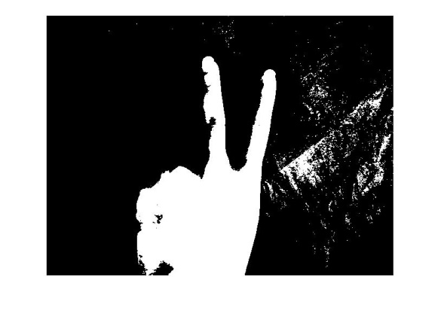
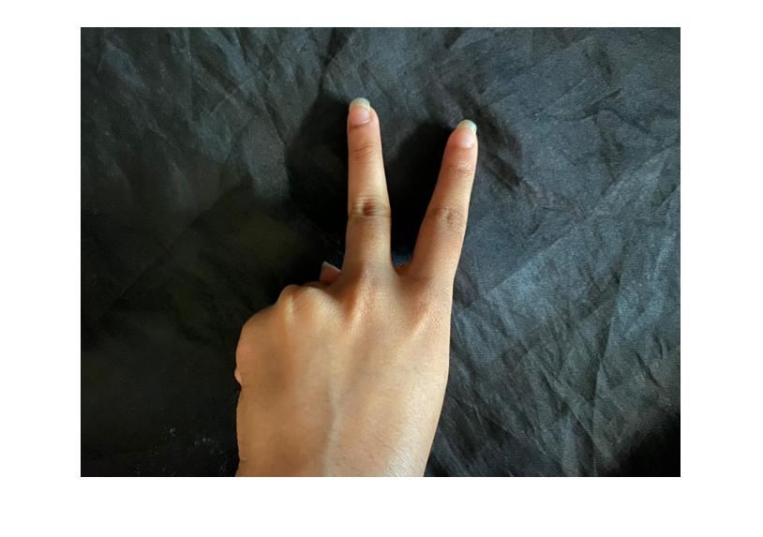
Image Processing
Demonstrating the procedure
We have followed a number of steps to ensure maximum accuracy and minimum runtime.
Getting number of fingers by palm area subtraction
Extracting palm area
Hole filling and isolated object removal
Hand segmentation using binarization
Convert image to black and white fully
Images taken by IP cam
5 images taken

Slide 6
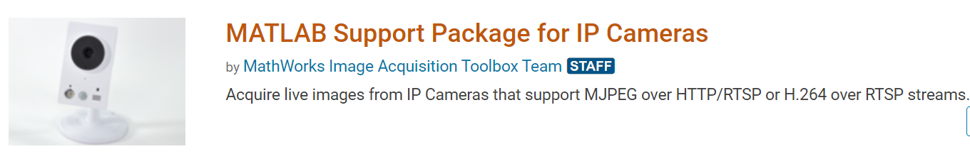
Hand Gesture Recognition In Real Time
This is an example of HGR used for device control. We use the following Matlab package to make our mobile camera act like an IP camera.
Counts number of fingers in Real Time.

Slide 7
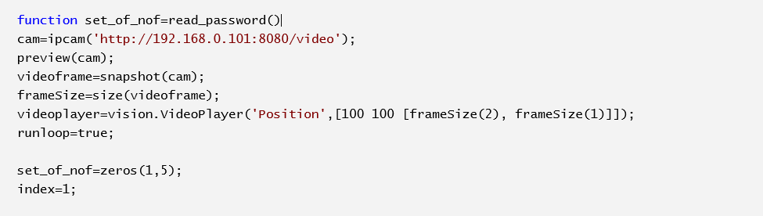
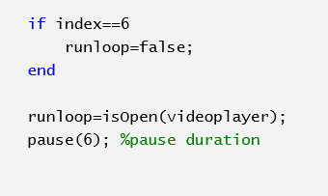
Hand Gesture Recognition In Real Time
Function returning a set of 5 digits
Address of IP camera
After taking 5 counts the loop ends
In between each data frame a pause of 6s is maintained

Slide 8

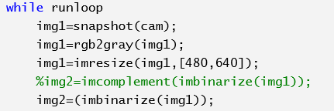
Image Processing
Step One:
Binarization

Slide 9
Image Processing
Step Two:
Hole filling and small area removal

Slide 10
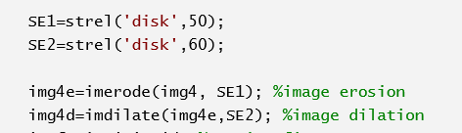

Image Processing
Step Three
Removing wrist area by erosion

Slide 11

Image Processing
Step Four
Dilation of wrist area

Slide 12
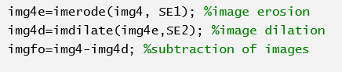
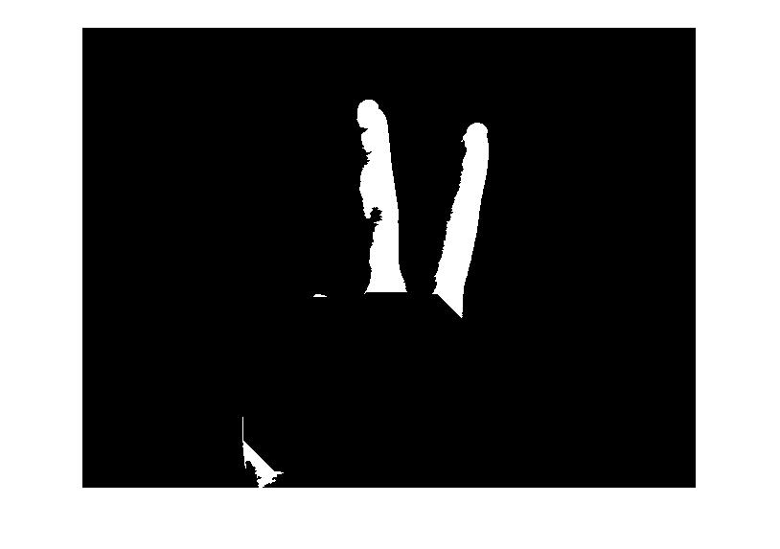
Image Processing
Step Five
Subtraction

Slide 13
Image Processing
Step Six
Cleaning
Total number of separate areas are counted

Slide 14
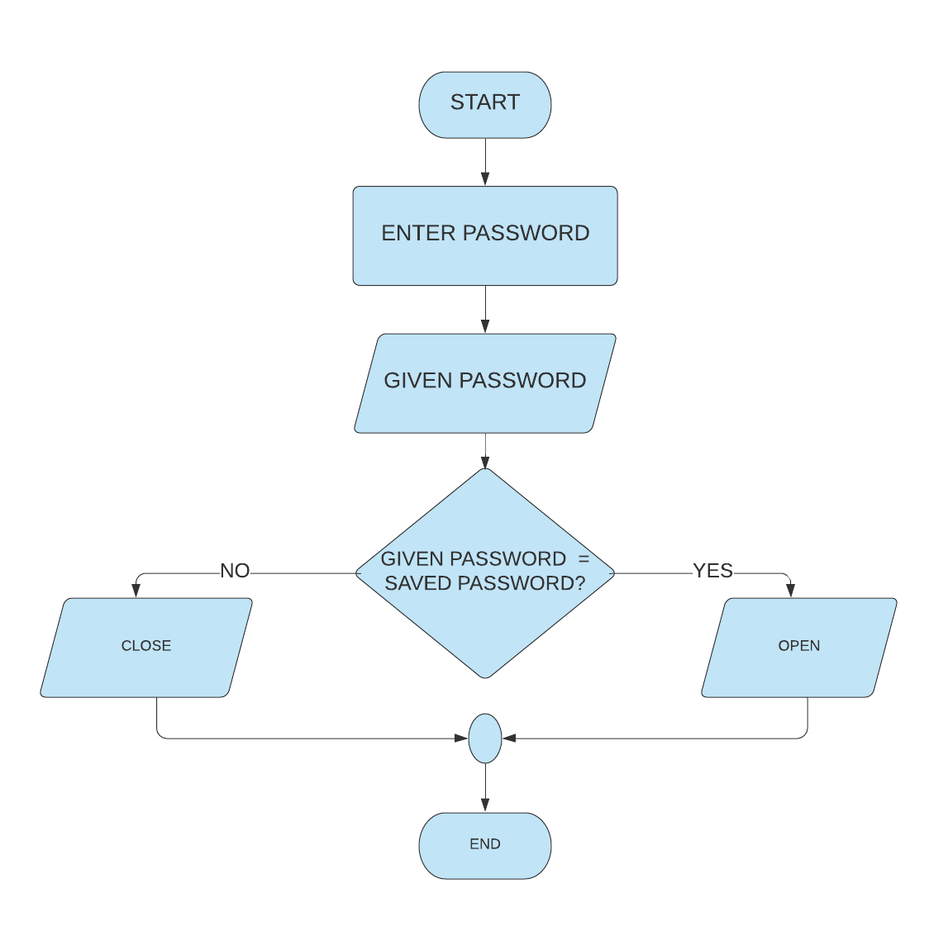
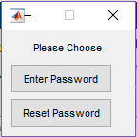
User Manual: Starting the Programme
Enter Password:
Starting Prompt:
Enter Password
Reset Password

Slide 15
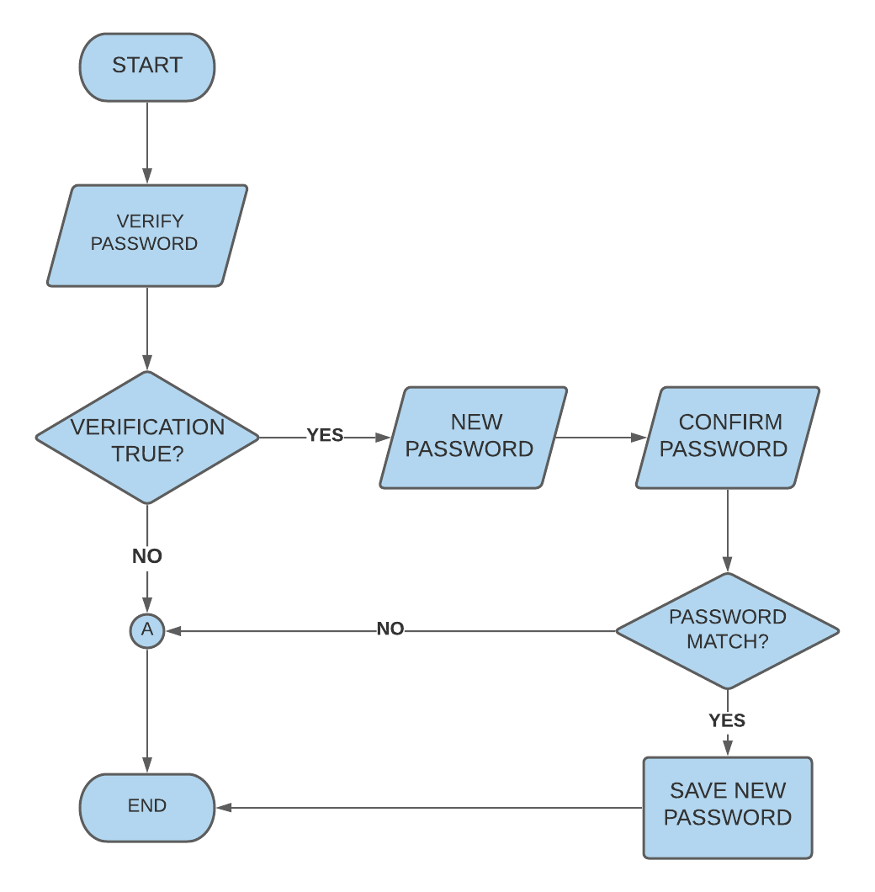
Starting the Programme
Reset Password:

Slide 16
LIMITATIONS
Can not separate background objects
Shadows and bright flashes of light causes errors during binarization
Problems with using Image Processing
Only one angle readable
Does not take position of finger into account
Arbitrary gestures can not be identified

Slide 17
Flow chart
Take picture
Open the door for correct password
VSPE
Compare input arguments
Microprocesssor
Compare password
This flowchart demonstrates the procedure after obtaining the password input
Display necessary message

Slide 18
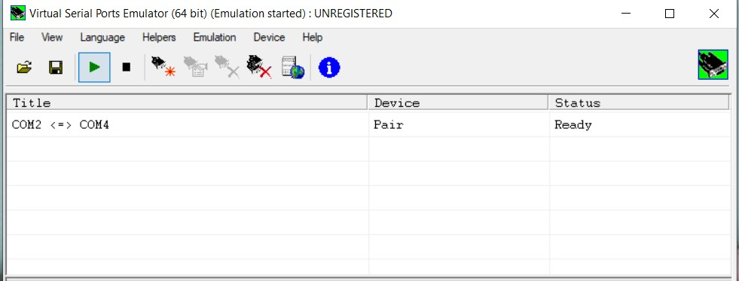
Virtual Serial Port Emulator (VSPE)
VSPE CONNECTION:
VSPE is a software which is able to create various virtual devices to transmit/receive data.
Two virtual ports are needed to establish connection between MATLAB and Proteus
COM2 and COM4 are two virtual ports are used to connect MATLAB and Proteus respectively.

Slide 19
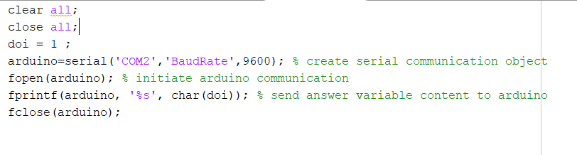
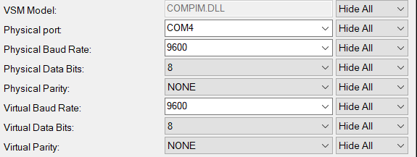
VSPE: Connecting MATLAB & Proteus
Creates a serial communication object
Sends variable content to arduino
Initiate arduino communication

Slide 20
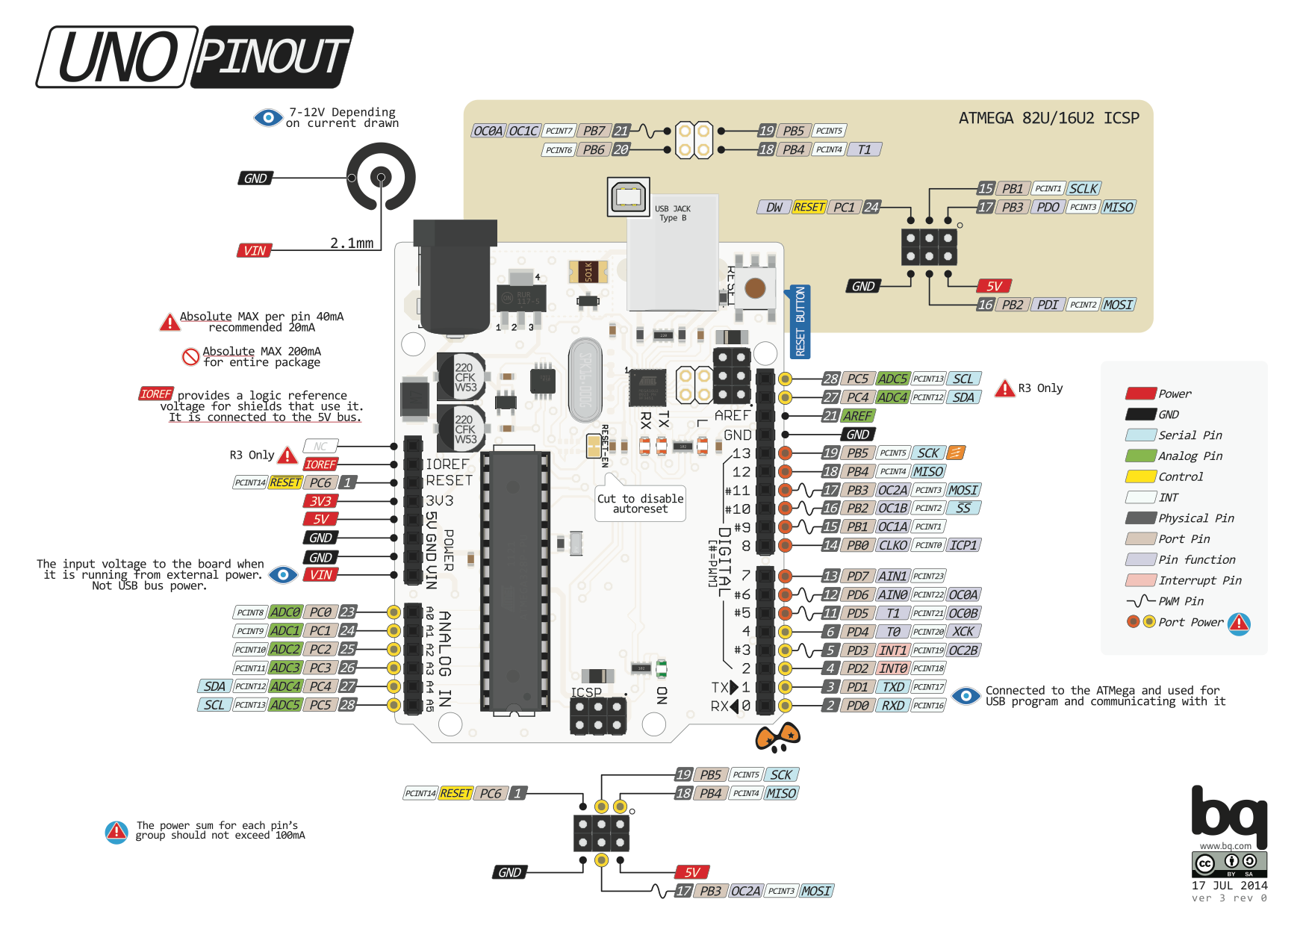

Arduino UNO PINOUT diagram

Slide 21
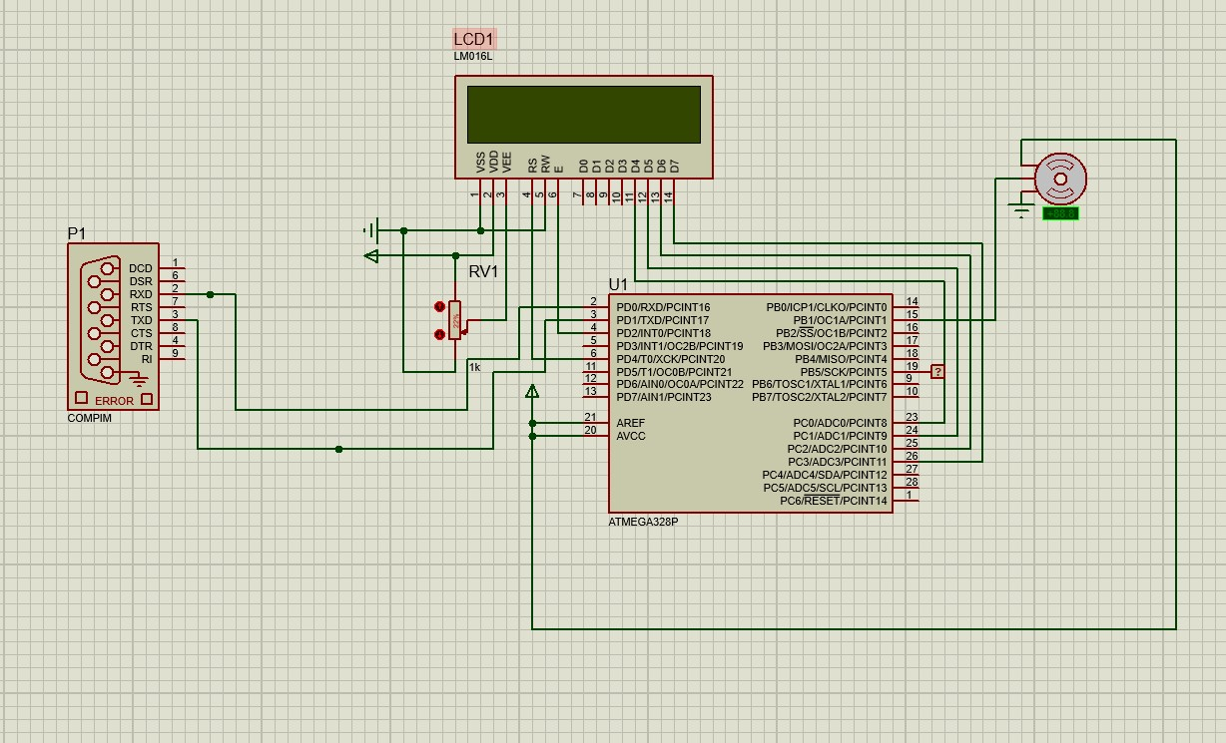
Schematic Diagram
The hardware part of this project was simulated using Proteus
The components used are:
Microprocessor, ATEMEGA328P
COMPIM
LCD Display, LM016L
Logic Probe
Motor- PWMSERVO
POT- HG

Slide 22
Microprocessor Programming
For incorrect input the servo motor does not rotate and thus the door remains locked.
“Wrong Password” is displayed on the LCD monitor
For correct input the servo motor turns 180 degrees and thus unlocks the door.
“Unlocked” is displayed on the LCD monitor
Arduino takes input through the serial port connecting the microprocessor.
Microprocesssor ATMEGA328P is programmed using Arduino IDE.

Slide 23
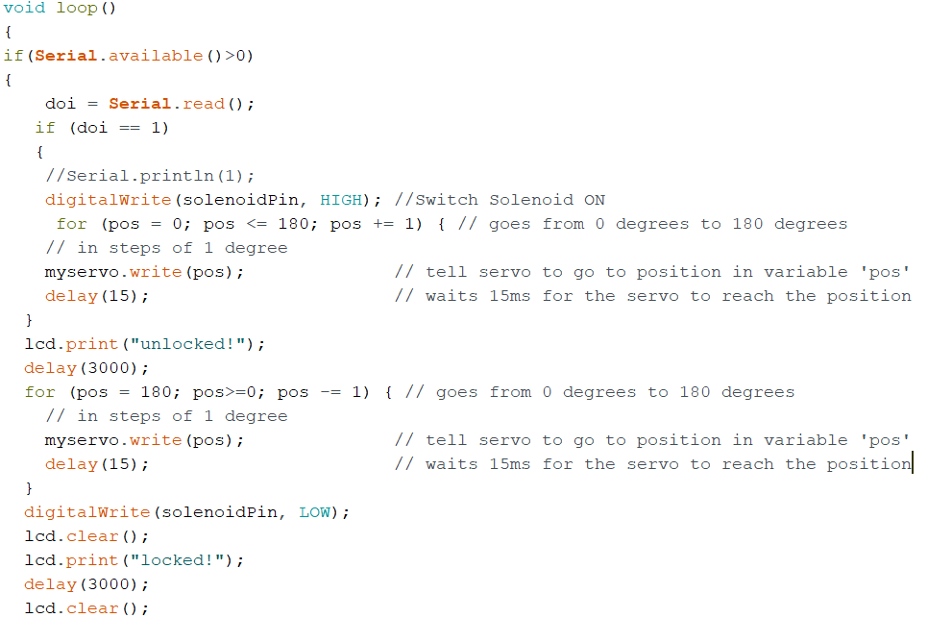
Arduino Code (for correct password)

Slide 24
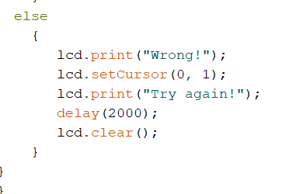
Arduino Code (for incorrect password)
If input is any number other than ‘1’
sets the LCD cursor to the second line .

Slide 25
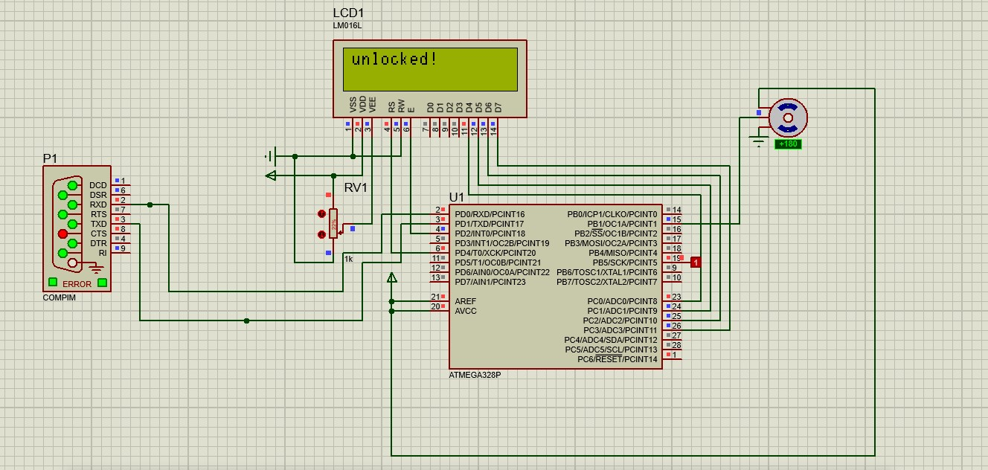
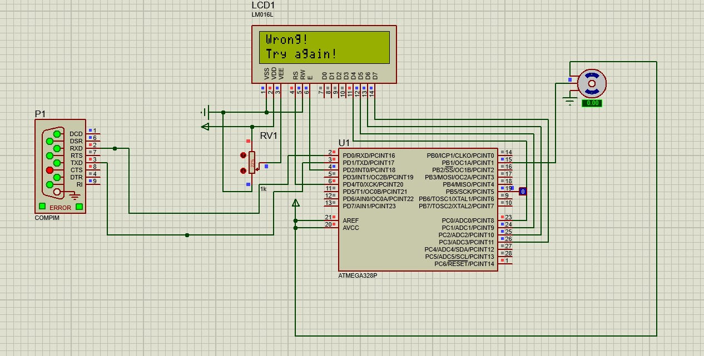
Visual Representation
Door unlocked when correct password is entered
Door remains locked when incorrect password is entered

Slide 26
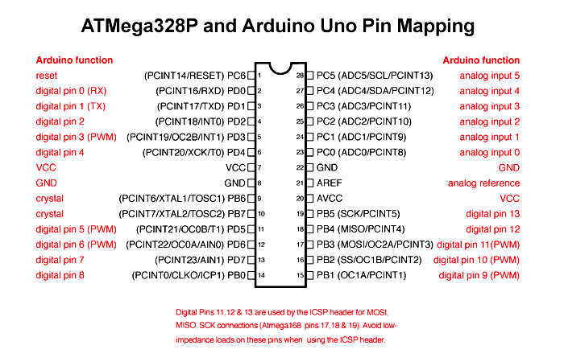
Pin Mapping
The input output pins of Arduino are mapped with that of the microprocessor ATMEGA328P using the diagram shown on the left.

Slide 27
Practical Implementation
of this project
A series of photo is taken by the IP camera and passed to a CPU connected to the security system
The MATLAB code is installed in the CPU
The MATLAB code analyses the input and passes necessary arguments to the microprocessor connected to the door circuit.
The microprocessor analyses the MATLAB command and unlocks the door if correct password is provided as input.

Slide 28



Team Contribution
Raisa Mashtura- 1706163
Subah Karnine- 1706174
Fariha Ferdousi- 1706143
Nausin Tabassum Kudrot- 1706158
Sadia Afrose- 1706161
IMAGE PROCESSING
HARDWARE SIMULATION

Slide 29
THANK YOU!
THANK YOU

